Slide 1
Templating Tools and Package Management
Templating Tools. Getting Started with Helm
Creating Simple Charts
SoftUni Team
Technical Trainers
Software University
https://softuni.bg

Slide 2
Have a Question?
sli.do
#Kubernetes
https://www.facebook.com/groups
/KubernetesOctober2021
Notes:
2

Slide 3
Homework Progress
Submit M3/4 until 23:59:59 on 15.12.2021
Submit M5 until 23:59:59 on 19.12.2021
Submit M6 until 23:59:59 on 26.12.2021
Submit M7 until 23:59:59 on 02.01.2022

Slide 4

Previous Module (M6)
Quick overview

Slide 5
Table of Contents
Health and Status Checks
Auditing and Logging
Troubleshooting
5
Notes:
5

Slide 6
The End is Near ☺
THIS MODULE
ONE
GO
MORE
AND
TO

Slide 7
Test Your Knowledge
Practice (exam-like) questions:
https://zahariev.pro/q/k8s
Will be available after 08:00 on 13.12.2021

Slide 8

This Module (M7)
Notes:
8

Slide 9
Table of Contents
Templating Tools
Getting Started with Helm
Creating Simple Charts
9
Notes:
9

Slide 10
Templating Tools
Notes:
10

Slide 11
What and Why?
In the typical situation, we want to be able to deploy an application to multiple environments or in multiple modes
These can be development, test, production, etc.
They may differ in terms of image name, image tag, service type, service port, etc.
We can either have multiple manifest sets
Or use some kind of tooling
dev
test
manifests
…
prod

Slide 12
Manual Approach
Perhaps this is the easiest, especially when dealing with either simpler or fewer manifests
Pros: familiar and easy to use tool – sed
Cons: manifests should be specially prepared with placeholders, and it is difficult to set none or some of them – always we should provide values for all
manifest.yaml (original)
manifest.yaml (template)
manifest.yaml (result)
apiVersion: v1
kind: Pod
metadata:
name: pod
spec:
containers:
- image: nginx:latest
name: main
apiVersion: v1
kind: Pod
metadata:
name: pod
spec:
containers:
- image: %image%:%tag%
name: main
apiVersion: v1
kind: Pod
metadata:
name: pod
spec:
containers:
- image: alpine:3.14
name: main
sed -e 's/%image%/alpine' \
-e 's/%tag%/3.14' manifest.yaml
https://www.gnu.org/software/sed/manual/sed.html

Slide 13
Kustomize
Native Kubernetes configuration management
Template-free way to customize application configuration
Simplifies the use of off-the-shelf applications
Built into kubectl as apply -k
Resulting manifest
base/main.yaml
apiVersion: apps/v1
kind: Deployment
metadata:
labels:
variant: dev
name: dev-appa
spec:
replicas: 5
selector:
matchLabels:
app: appa
variant: dev
template:
metadata:
labels:
app: appa
variant: dev
spec:
containers:
- name: main
apiVersion: apps/v1
kind: Deployment
metadata:
name: appa
spec:
replicas: 1
selector:
matchLabels:
app: appa
template:
metadata:
labels:
app: appa
spec:
containers:
- name: main
kustomization.yaml
apiVersion: kustomize.config.k8s.io/v1beta1
kind: Kustomization
namePrefix: dev-
commonLabels:
variant: dev
patchesStrategicMerge:
- patch.yaml
resources:
- ../../base
overlays/dev/patch.yaml
apiVersion: apps/v1
kind: Deployment
metadata:
name: appa
spec:
replicas: 5
https://kustomize.io/

Slide 14
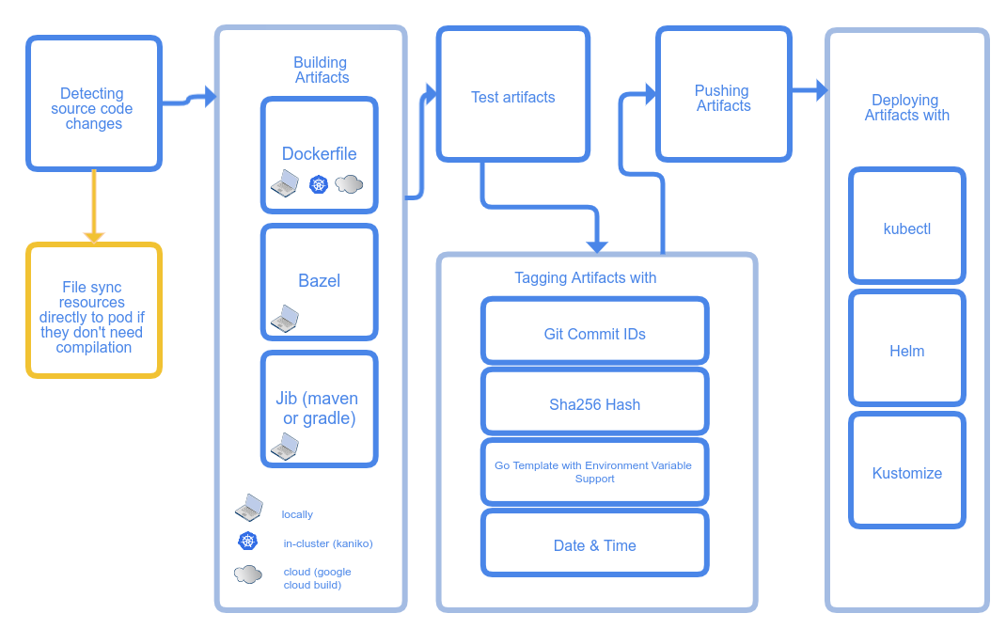
Skaffold
Focused more on the pipeline
Handles the workflow for building, pushing and deploying your application
https://skaffold.dev/

Slide 15
Other (Templating and Workflow) Tools *
Kubes
https://kubes.guru/
YQ
https://mikefarah.gitbook.io/yq/
YTT
https://carvel.dev/ytt/
Write Your Own (using client libraries)
https://kubernetes.io/docs/reference/using-api/client-libraries/
Helm
https://helm.sh/

Slide 16

Practice
Live Exercise in Class (Lab)
Notes:
16

Slide 17
Getting Started with Helm
Notes:
17

Slide 18
What is Helm?
It is a package manager for Kubernetes
Its packages are called charts
Charts help us define, install, and upgrade complex applications
They are easy to create, version, share, and publish
Charts are organized in repositories
Repositories may be accessed either directly or via a hub
One such hub is the ArtifactHUB (https://artifacthub.io/)
https://helm.sh/

Slide 19
Architecture
Two parts in one executable – client and library
Kubernetes Cluster
API Server
Release
Secret
Helm
Executable
Service
Pod
client
library
Chart
https://helm.sh/docs/topics/architecture/

Slide 20
Charts (1)
Collection of files that describe a related set of Kubernetes resources
A single chart might be used to deploy something simple like a single pod with nginx, redis, etc.
Or a set of different resources. For example, a full web app stack with HTTP servers, databases, caches, and so on
They are created as a set of files with particular names and structure and then packaged into versioned archives
https://helm.sh/docs/topics/charts/

Slide 21
Charts (2)
Chart is organized as a collection of files inside of a directory
The directory name is the name of the chart without versioning information
wordpress/
Chart.yaml # A YAML file containing information about the chart
LICENSE # OPTIONAL: A plain text file containing the license for the chart
README.md # OPTIONAL: A human-readable README file
values.yaml # The default configuration values for this chart
values.schema.json # OPTIONAL: A JSON Schema for imposing a structure on the values.yaml file
charts/ # A directory containing any charts upon which this chart depends.
crds/ # Custom Resource Definitions
templates/ # A directory of templates that, when combined with values,
# will generate valid Kubernetes manifest files.
templates/NOTES.txt # OPTIONAL: A plain text file containing short usage notes
https://helm.sh/docs/topics/charts/

Slide 22
Practice
Live Exercise in Class (Lab)
Notes:
22

Slide 23
Creating Simple Charts
Notes:
23

Slide 24
Chart Creation
We can start either from a skeleton chart or from an existing manifest (or set of manifests)
In any case, we should have at least the following
Folder named after our chart to store its files
Chart.yaml file to describe it
values.yaml file to contain any default values
templates/ sub-directory for the actual chart template files
https://helm.sh/docs/chart_template_guide/getting_started/

Slide 25
Parametrization
We can make our charts more adaptable to the environment
For this, we can use substitutions in the form {{ source }}
Values that we use can come from various sources
Some of them are the following top-level built-in objects
Release – here we have Release.Name, Release.Namespace, etc.
Values – data coming from the values.yaml file, empty by default
Chart – data from Chart.yaml like Chart.Name, Chart.Version, etc.
https://helm.sh/docs/chart_template_guide/builtin_objects/

Slide 26
Practice
Live Exercise in Class (Lab)
Notes:
26

Slide 27
Questions?
Notes:
27

Slide 28


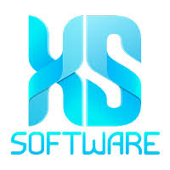


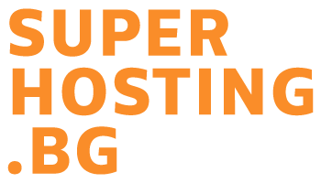





SoftUni Diamond Partners

Slide 29


Educational Partners

Slide 30

License
This course (slides, examples, demos, exercises, homework, documents, videos and other assets) is copyrighted content
Unauthorized copy, reproduction or use is illegal
© SoftUni – https://about.softuni.bg/
© Software University – https://softuni.bg
Notes:
30

Slide 31
Trainings @ Software University (SoftUni)
Software University – High-Quality Education, Profession and Job for Software Developers
softuni.bg, about.softuni.bg
Software University Foundation
softuni.foundation
Software University @ Facebook
facebook.com/SoftwareUniversity
Software University Forums
forum.softuni.bg
Notes:
31

